Slide 1
Quantify and interpret chance-probability 1

Slide 2
Probability
Random outcome
= set of possibilities but we do not know which
one will occur
Sample space (S) = set of all possible outcomes
Sample point = one outcome
Event (E) = any subset of the sample space
Probability = measure of how likely an event occur

Slide 3
Probability
Probability scale:
0
Impossible (never)
unlikely
0.5
Even chance
likely
1
Certain (always)

Slide 4
Type of Events
Single event
event which involve the use of 1 item only
Compound event
event which involve the use of 2 or more item
Complement event
If A is an event within the sample space S of an
activity or experiment, the complement of A, A'
consists of all outcomes in S that are NOT in A.

Slide 5
Probability laws
Addition Law
Conditional Probability
Multiplication Law
Mutually and Independent Events

Slide 6
Addition Law
In Addition Law,
  word “or” is used

Slide 7
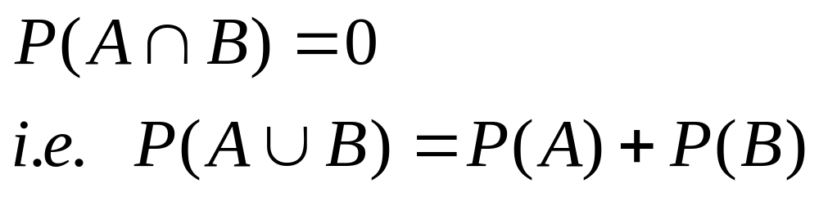
Mutually Exclusive Event
Two events that have NO outcomes in common are called mutually exclusive.
These are events that cannot occur at the same time.
If two events are mutually exclusive,
A
B

Slide 8
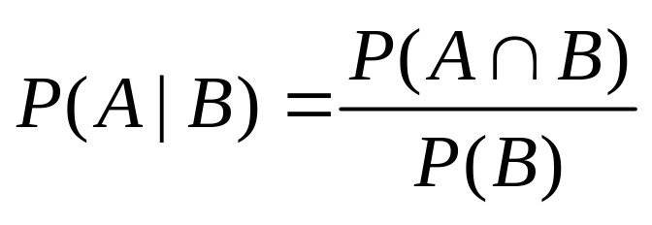
Conditional Events
The conditional probability of an event A in relationship to an event B is the probability that event A occurs given that event B has already occurred.
The notation for conditional probability is P(A|B), read as the probability of A given B.
The formula for conditional probability is:

Slide 9
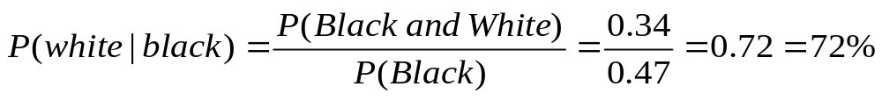
Conditional Events
Example 1
A jar contains black and white marbles. Two marbles
are chosen without replacement. The probability of selecting a black
marble and then a white marble is 0.34, and the probability of
selecting a black marble on the first draw is 0.47. What is the
probability of selecting a white marble on the second draw, given
that the first marble drawn was black?

Slide 10
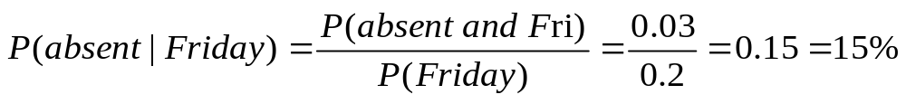
Conditional Events
Example 2
The probability that it is Friday and that a student is absent is 0.03.
Since there are 5 school days in a week, the probability that it is
Friday is 0.2. What is the probability that a student is absent given
that today is Friday?

Slide 11
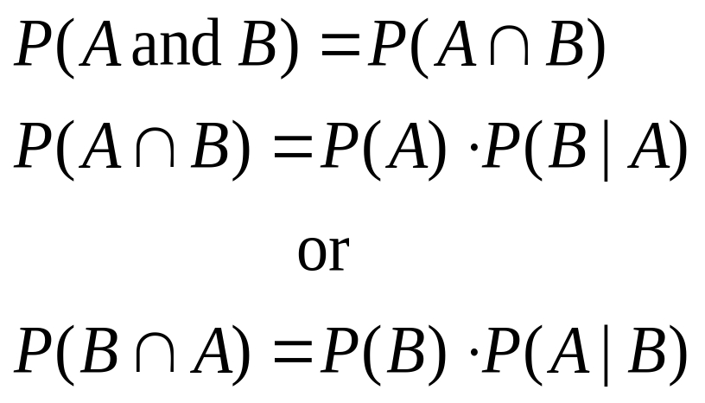
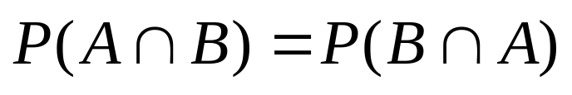
Multiplication Law
In Multiplication Law,
  word “and” is used

Slide 12
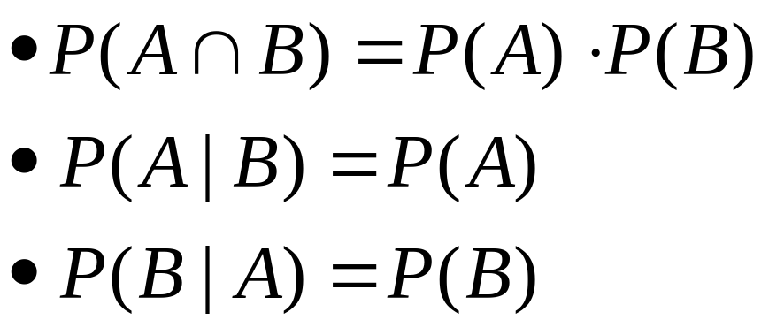
Independent Event
Two events are said to be independent if the result of the second event is not affected by the result of the first event.
If two events are independent,

